Slide 1


Data Analytics Partnership Program
Hourly Energy Price Prediction
Presentors:
Wenhan Sun, Fanyi Zhang, Kanghua Mai

Slide 2



Our Team
Wenhan Sun
MSBA
University of Miami
Fanyi Zhang
MSBA
University of Miami
Kanghua Mai
MSBA
University of Miami

Slide 3

Content
Objectives
Descriptive Analysis
Feature selection
Model Fitting
Summary & Next Steps
What we learned
Q&A
Notes:
Recommendations from Data Science Team
· Focus on producing a report following observations with respect to what data may influence regional LMP…we need to quickly dive deeper into what factors are influencing DA pricing
· Generate figures that display results, metrics over time, and trends of the data such that it can be reviewed by the data science team
Recommendations on Final Report Out (Executive Summary)
· Begin documenting the feature selection and modeling approaches taken
· What novel approaches were taken?
· What industry standard practices were used?
· What worked?
· What didn’t work?
· What were the team’s learnings throughout the project?
· What recommendations would the team give NEE going forward?
· Keep in mind that the audience for the final report out will likely not be day-to-day data scientists, so while deep technical information is great for our twice-weekly sessions and back-up slides, the story we want to tell here needs to make sense to a broader audience as well

Slide 4
Business Objectives
Helping NextEra Energy to forecast the Day Ahead market energy prices
More accurate results will provide a stronger competitive strategy for energy trading
Model Objectives
Figuring out most important factors that will influence energy pricing
Forecast 24 hourly Day Ahead Locational Marginal Pricing (DALMP) by fitting a time series model
Notes:
Use Case 2 – Develop an algorithm and a prediction model for energy prices based on market factors.
· Problem: There has been a lot of deregulations and increased players in the energy market which is transforming energy industry. We want our students to come-in and help us with energy market analysis and how various factors are affecting energy pricing. Our goal is to develop a predictive model that NEER can utilize to manage energy trading.
· Project: Use data science and collection of historical data to identify factors impacting energy trading & marketing.
The goal of this spring project is to develop an algorithm that can detect which factors impact the pricing fluctuations and deliver a prediction model that can recommend optimum price faster.
Andrew:
Replace Location to Locational for LMP definition.

Slide 5
Data Description: Feature Utilization
Weather
Prices
Actual
Forecast
Normal
RTLMP, DAENERGY, DALOAD, ...
Heating Degree Day (HDD), Cooling Degree Day (CDD), Cloud Cover Percent, ...
! Not available when forecasting
Dewpoint, Precipitation (in inches), Wet-bulb temperature, Wind speed ...
Notes:
Chase:
RTLMP is listed twice - should this be RTLMP and DALMP?
Would probably be a good idea to use actual data names rather than the initialisms here, otherwise most of our audience will not know what they are

Slide 6
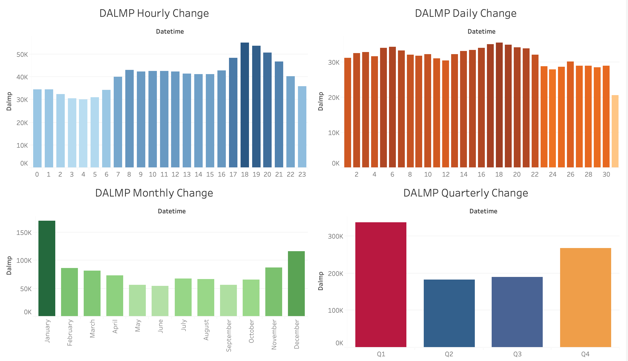
Data Visualization

Slide 7
Data Description: Created pattern features
Seasonal feature:
Create a season feature based on seasonality pattern in Connecticut.
Quarterly feature:
Periods=91 days, fourier.order=5, prior.scale=2.5
Daily feature:
Periods=1 day, fourier.order=3, prior.scale=5
Fourier order: A parameter determines how quickly the seasonality can change (trend smoothness)
Prior.scale: controls how much of an effect the regressor has on predictions (trend height)
Notes:
Andrew:
Describe the effect of the prior scale per an increase or decrease in value.
Ex: Difference between 1 and difference between 5 for the Daily feature in the slide.
More or less influence.
Explain why these periods were selected. This would be good discussion.
Fanyi: I think prior scale affects the height of the seasonality bumps whereas the order affects the width.
Increasing the number of Fourier terms allows the seasonality to fit faster changing cycles, but can also lead to overfitting:

Slide 8
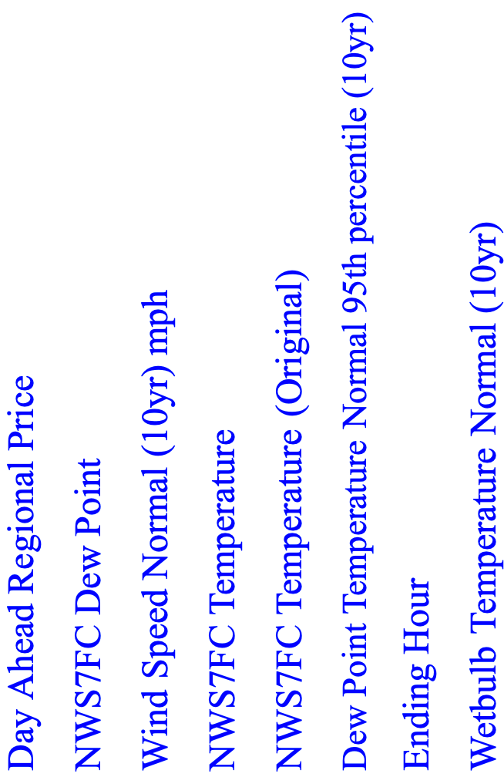
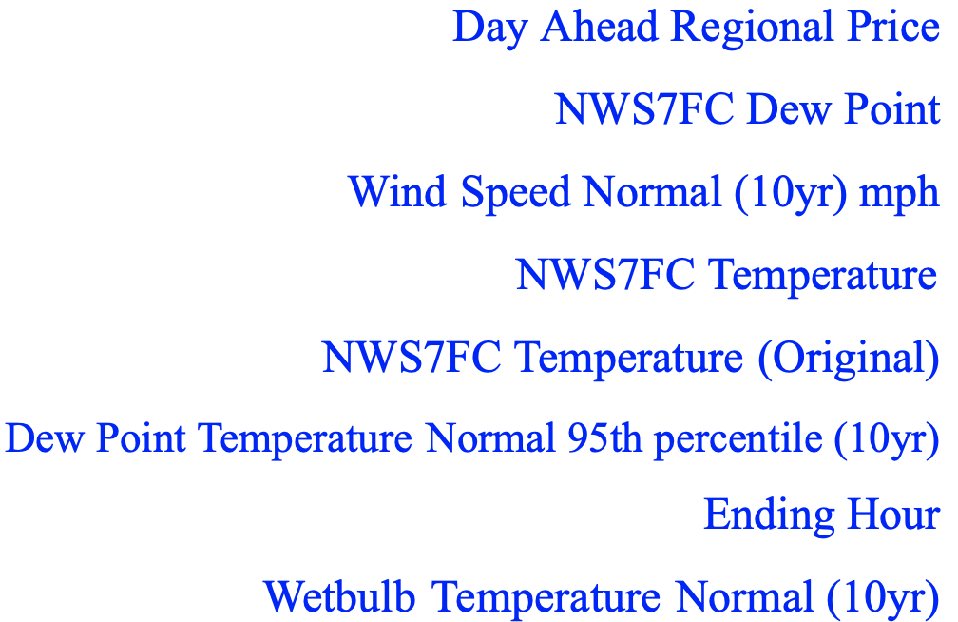
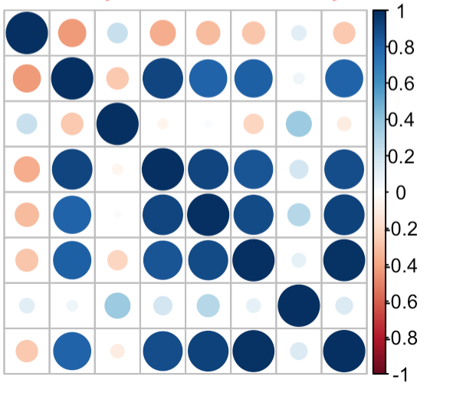
Features Selection: methods
1. Correlation plot
Pros: can easily observe the negative/positive correlation with each variable.
Cons: For some features with high correlation, we cannot make decision if we should drop them in the model.
Notes:
Chase:
May want to replace data field names with more friendly and meaningful names
Day Ahead Regional Price
NWS7FC Dew Point
Wind Speed Normal (10yr) mph
NWS7FC Temperature
NWS7FC Temperature (Original)
Dew Point Temperature Normal 95th percentile (10yr)
Ending Hour
Wetbulb Temperature Normal (10yr)

Slide 9
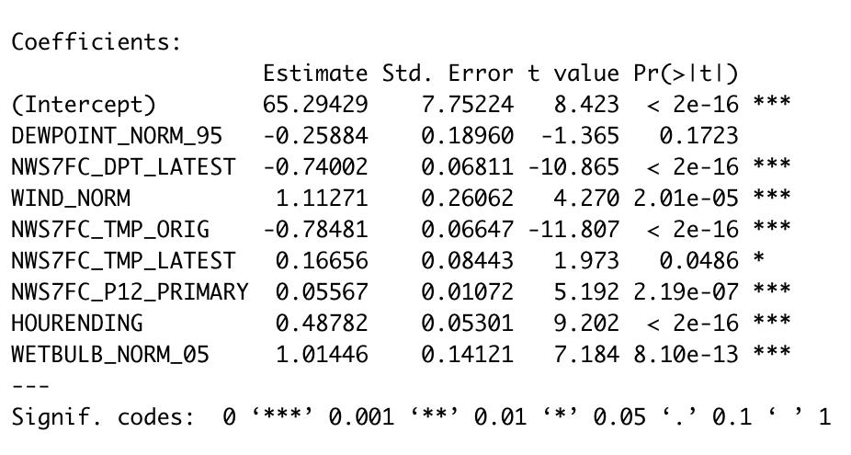
Features Selection: methods
2. Stepwise
Pros: can help decide which feature is more important to predict DALMP based on regression models.
Cons: Sometimes some important variables can be not significant based on different variable selection.
Stepwise: stepwise regression is a method of filling regression models in which the choice of predictive variable is carried out by an automatic procedure

Slide 10
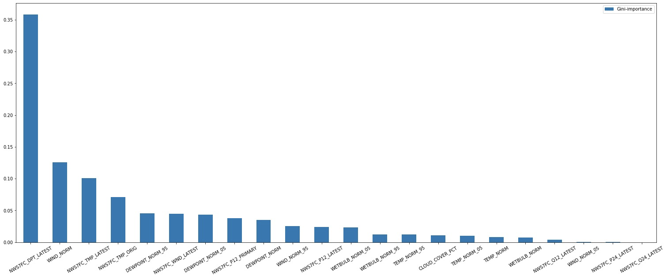
Features Selection: methods
3. Random Forest Importance plot： Pros: Feature importance is correlated based on each non-correlated trees. Cons: Some features have less independent influence to DALMP may be ignored.

Slide 11
Feature selection: Result
Final feature selection:
Numeric: Dew Point Temperature Normal 95th percentile (10yr), NWS7FC Dew Point, NWS7FC Temperature (Original),NWS7FC Temperature, Wind Speed Normal (10yr) mph, NWS7FC_Q12_LATEST, Wetbulb Temperature Normal 5th percentile (10yr), NWS7FC Precipitation 12 (Primary), HOURENDING
Category: MONTH, PEAKTYPE
Created feature: Quarterly, Daily, Season
Prepare DALMP:
Variance not constant + let final DALMP>0 log(DALMP) before model fitting

Slide 12

Prophet Model - developed by Facebook
Works best with time series that have strong seasonal effects
Fits many kinds of seasonalities: yearly, quarterly, monthly, daily, etc.
Robust to shifts in the trend
Forecasts well on a large scale of time
* Official website : https://facebook.github.io/prophet/
Notes:
You name it

Slide 13
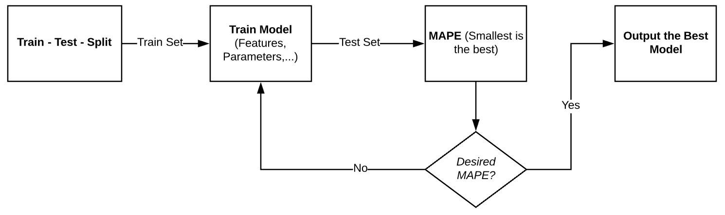
Modeling Process
*Train Dataset: 3/1/2017 01:00:00 - 5/31/2019 23:00:00
*Test Dataset: 6/1/2019 00:00:00 - 12/31/2019 23:00:00

Slide 14
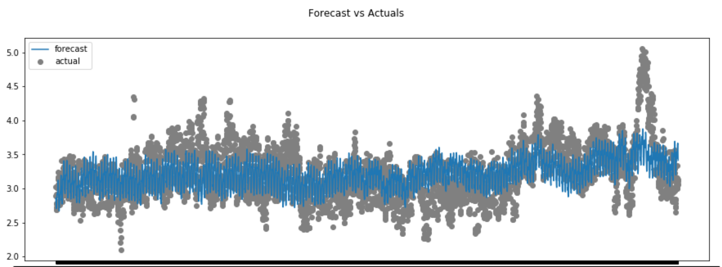
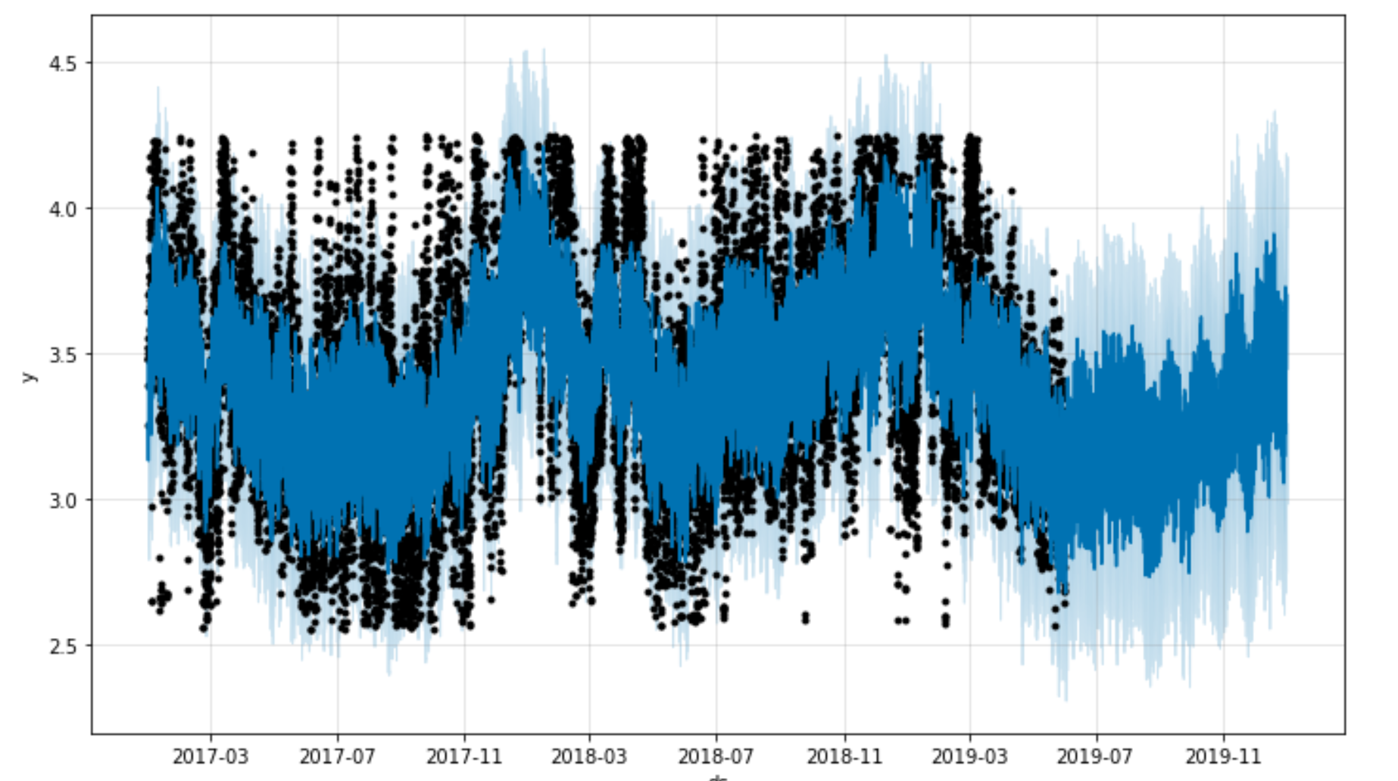
Model Result
Start: 2019-06-01 00:00:00
End: 2019-12-31 23:00:00
Pros:
Captured the upward trend at the second half year
Indeed robust to shifts in the trend
Cons:
Lacked of accuracy on predicting extreme values

Slide 15
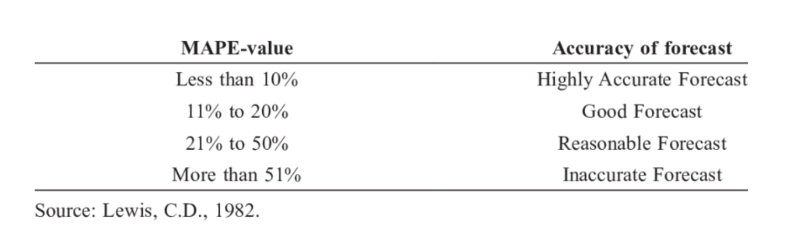
Error Metrics - How does the model perform?
MAPE_All = 38.2%
Reasonable Forecast
Table Error Metrics without extreme values
Methods | MAPE | # of Extreme Values | % of Extreme Values | Accuracy of forecast
Confidence interval | 15.6% | 790/5137 | 15.4% | Good Forecast
+/- 3 standard deviations | 19.4% | 190/5137 | 3.7% | Good Forecast
*MAPE: the smaller, the better

Slide 16
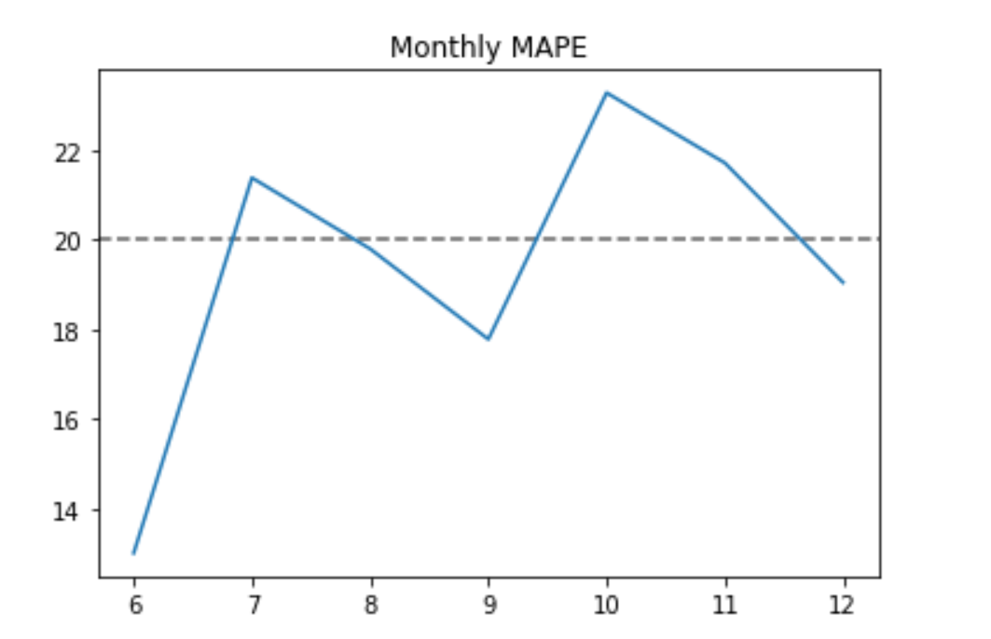
Monthly MAPE - How to improve model?
MAPE-values | months | Accuracy of forecast
11% ~ 20% | 6,8,9,12 | Good Forecast
21% ~ 50% | 7,10,11 | Reasonable Forecast
Conclusion:
varied a lot
Reason:
some months had extreme DALMP, while the others might not
Solution:
fit models month by month

Slide 17
Summary
Influential Features：
Weather: Wind Speed, Dew Point Temperature
Seasonality: Hours, Peaktype
Model
Captured the trends and shifts well
Reasonable forecast on average, Good forecast without extreme values

Slide 18
Next Steps - to improve forecasting accuracy
Add ‘actual’ type features: Heating Degree Day, Cooling Degree Day, Cloud Cover, Day Ahead types
Shrinkage the forecasting range: fit models month by month [ should capture the extreme values better ]
Deeper explore Prophet
Notes:
Chase:
May want to replace initialisms of data names with more friendly names
May want to mention hand-off to NEE team and what that might include (e.g.hand-off of any code, documentation, etc)

Slide 19
What we learned from the Capstone Project
Notes:
It is a great experience for us that we can able to practice our coding skills on real life data. We have learned how to corporate with each other and how to communicate with Next Era Energy teams. The Next Era Energy team has given us so many advises that are really helpful for us to completed the project and will benefit us to continue our career on business analytics.
We learned how to deal with hourly changing data, how to build a new model to fit these kind of data, how to do different kind of data selection, and more importantly, learn how to understand the energy company process on prices. For all of these, we are really appreciated Next Era Energy offers this opportunity for us. Thank you so much. We are looking forward to that Next Era Energy can continue corporate with our MSBA program.

Slide 20
Q&A
Thank you!

Slide 21
Appendix A - Feature Engineer
Data quality check (duplicates, missing values, outliers, data types)
Duplicates: None
Outliers: Drop outliers outside +/- 3 standard deviations
Missing value: replace all NA to 0 (percentage of missing value is small)
Created seasonality features
Add_seasonality regressor: quarter, daily. Create a new season feature.
Scale feature: standardize, prior.scale, fourier.order

Slide 22
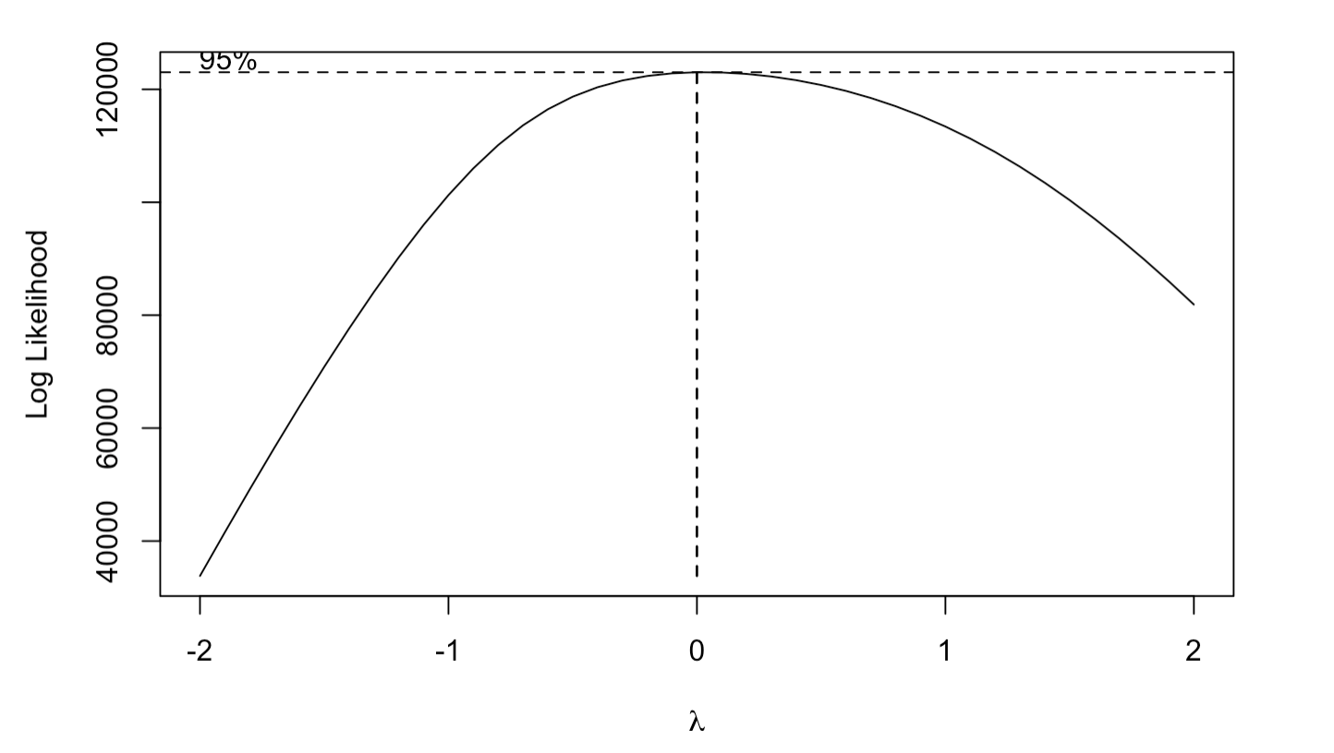

Appendix B - BoxCox Transformation for DALMP
Boxcox Test on DALMP
= 0
Logarithm on DALMP
DALMP -> LOGDALMP
* The predicted accuracy of LOGDALMP > DALMP

Slide 23
Appendix C - Feature Definitions
Wet-bulb temperature: The wet-bulb temperature (WBT) is the temperature read by a thermometer covered in water-soaked cloth (wet-bulb thermometer) over which air is passed.
Dew point: the atmospheric temperature (varying according to pressure and humidity) below which water droplets begin to condense and dew can form.
HDD: A heating degree day (HDD) is a measurement designed to quantify the demand for energy needed to heat a building.
CDD:A cooling degree day (CDD) is a measurement designed to quantify the demand for energy needed to cool buildings.

Slide 24
Appendix D - Train Test Splitting
Train-test split ( 80%-20% )
Train Dataset: 3/1/2017 01:00:00 - 5/31/2019 23:00:00
Test Dataset: 6/1/2019 00:00:00 - 12/31/2019 23:00:00

Slide 25
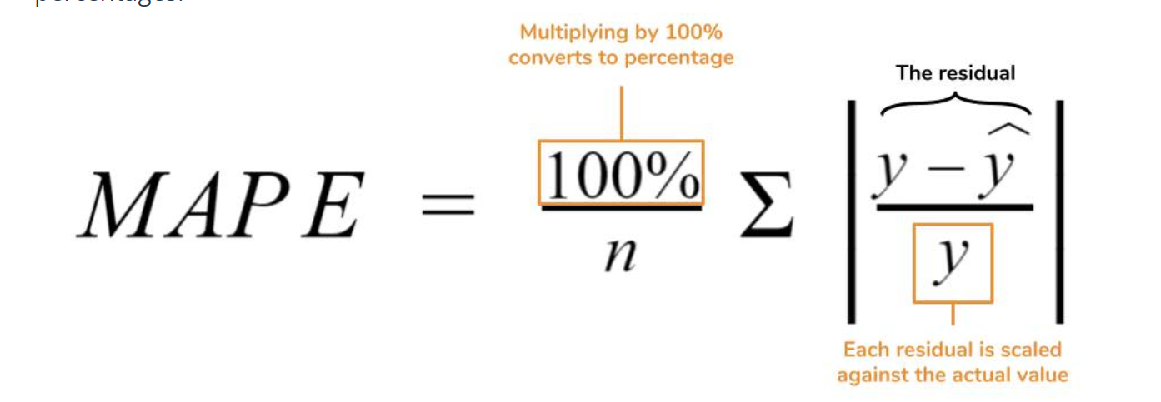
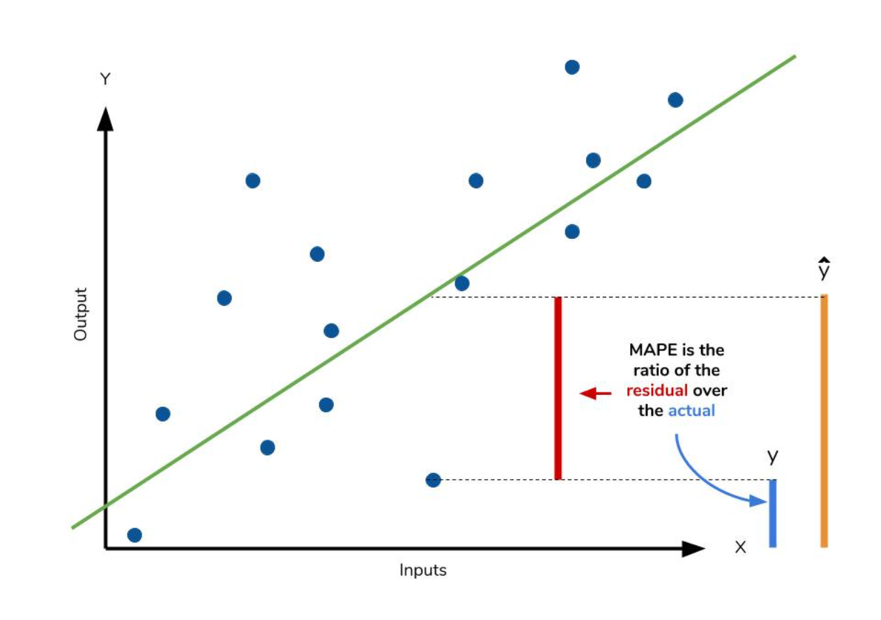
Appendix E - MAPE
MAPE is how far the model’s predictions are off from their corresponding outputs on average. MAPE is robust to the effects of outliers thanks to the use of absolute value.

Slide 26
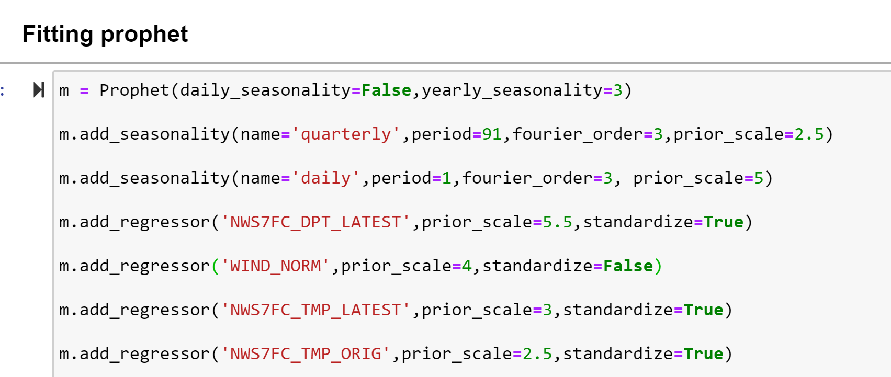
Appendix F - Codes for model fitting
...

